Slide 1


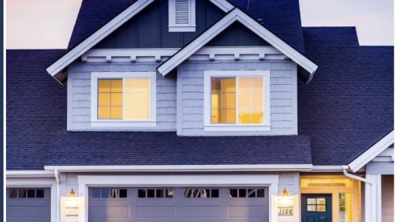

Your Real Estate
Live Your Dreams
Backhaus‘ King County Real Estates

Slide 2
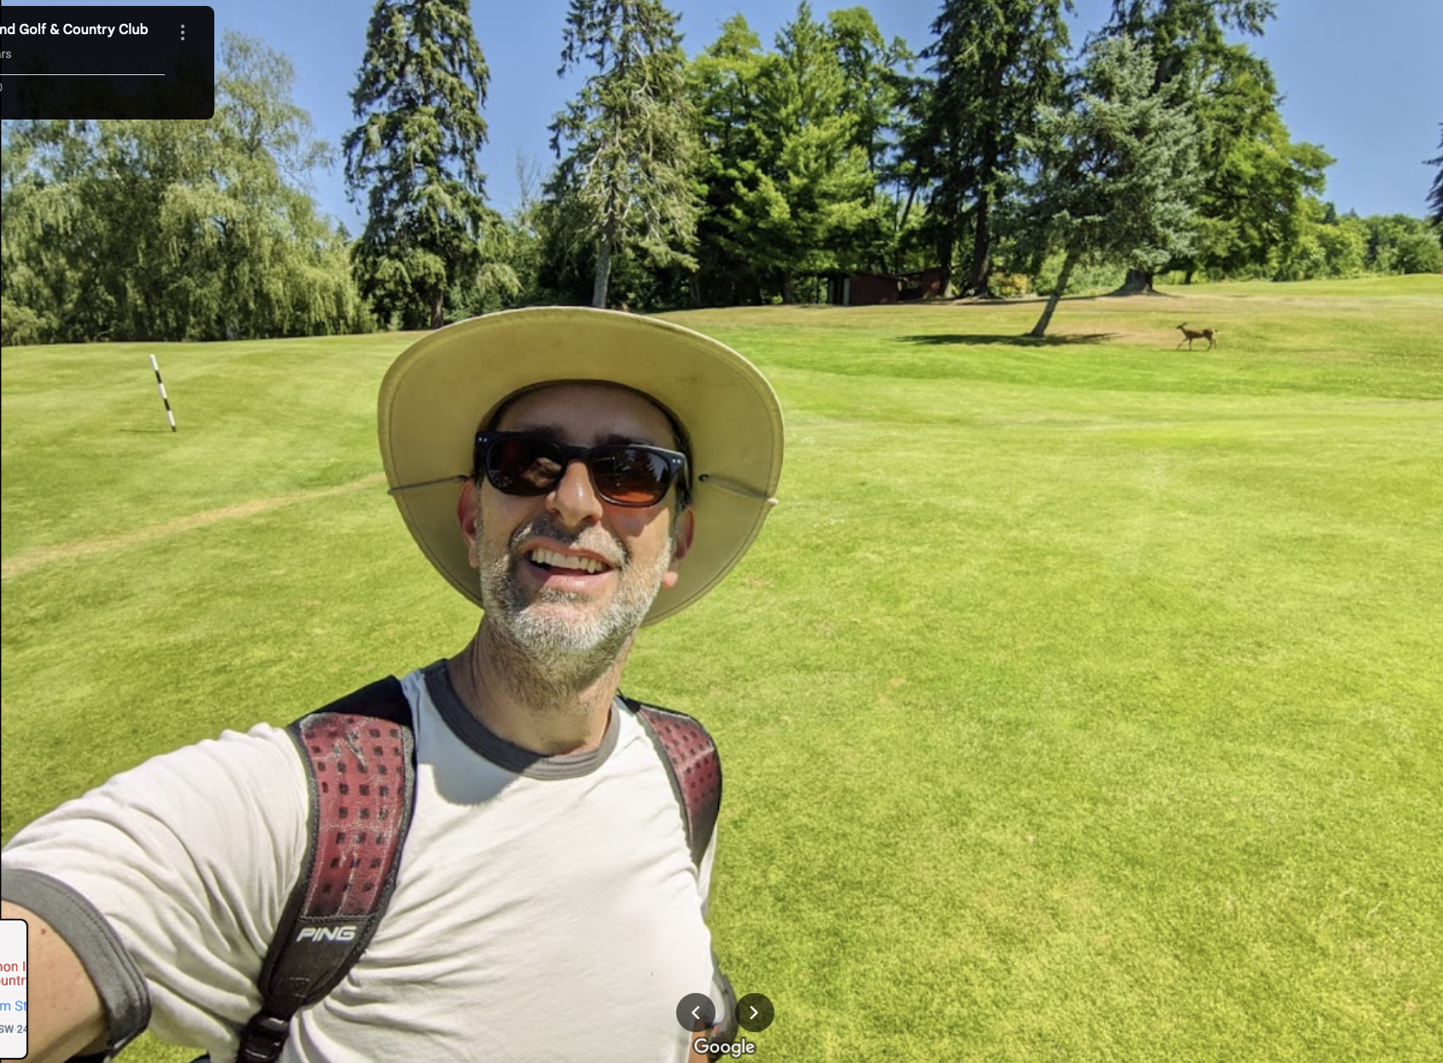
Meet Erin Robinson
z

Slide 3
Erin Robinson
loves his family
active in sports
exploring nature
culturally interested
z

Slide 4
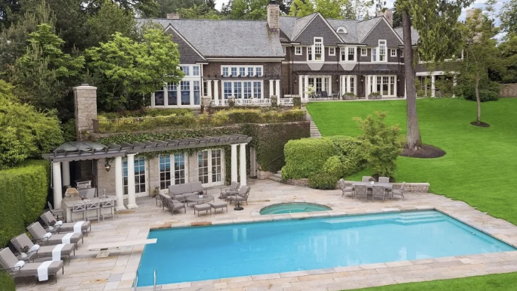
Clients Checklist Erin Robinson
4+ bathrooms
big lot
tennis court, golf & pool
historic house
no waterfront
unlimited Budget

Slide 5
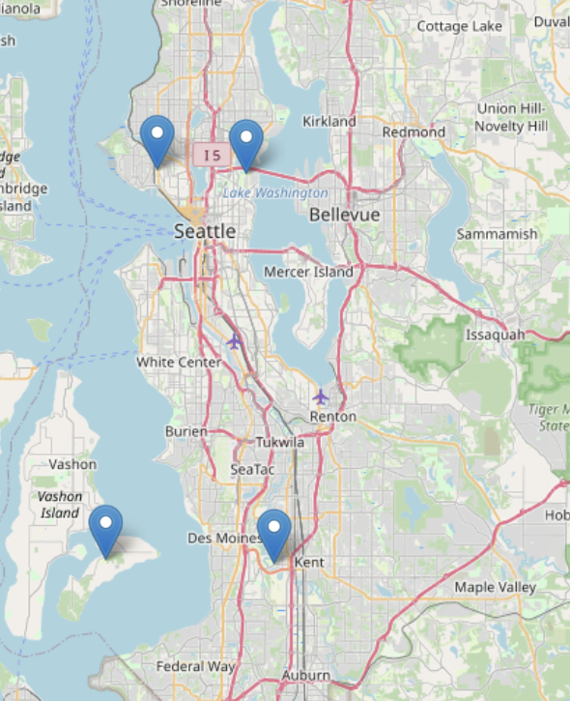
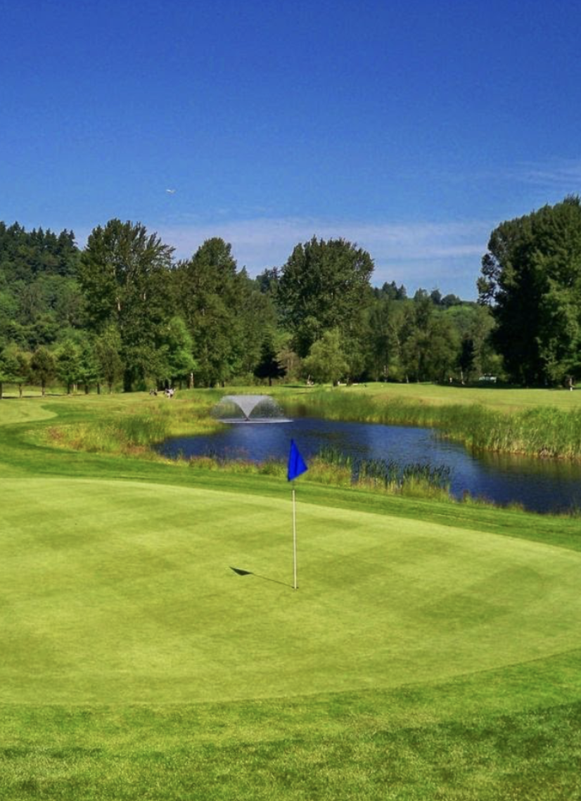
Golf Resorts Kings County
Interbay Golf Center
Broadmoor Golf Club
z
Vashon Island Golf
Riverbend Golf- Comp

Slide 6
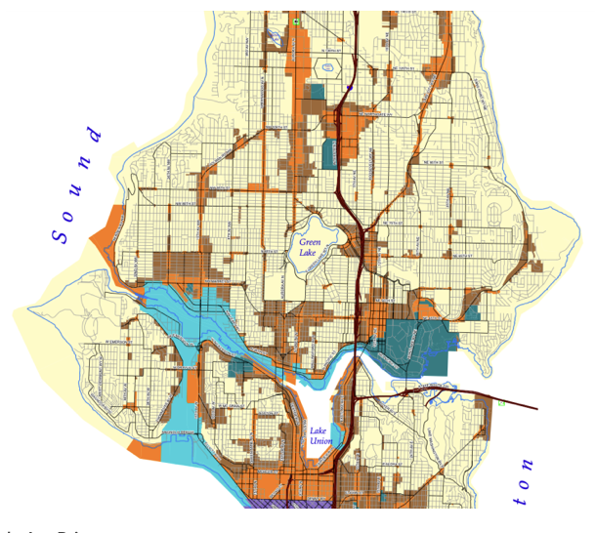
Our Database
21.500 Houses per year
Ranges from $80.000 to $8.000.000
Detailed information about condition, floor plan, property, neighbourhood, year of construction
We are the experts to find your dream home.

Slide 7
House | Bathrooms | Lot (sqft) | Lving (sqft) | Kings County Grade | Year of construction | Neighbourhood | Price | Zipcode | Map
10543 | 4.25 | 308.080 | 3.300 | 9 | 1976 | 90.604 | 729.000 | 98070 | OpenMaps
14172 | 4.00 | 30.120 | 4.200 | 11 | 1933 | 12.200 | 2.230.000 | 98112 | OpenMaps
18314 | 4.75 | 24.085 | 4.575 | 10 | 1926 | 9.687 | 2.920.000 | 98112 | OpenMaps
3381 | 4.75 | 13.431 | 5.410 | 10 | 1941 | 11.596 | 2.540.000 | 98112 | OpenMaps
5697 | 4.75 | 13.180 | 6.390 | 10 | 1940 | 8.137 | 2.470.000 | 98112 | OpenMaps
10435 | 4.00 | 11.765 | 4.260 | 11 | 1939 | 10.408 | 3.400.000 | 98112 | OpenMaps
18462 | 4.00 | 11.750 | 7.710 | 12 | 1904 | 8.325 | 3.300.000 | 98112 | OpenMaps
14499 | 4.50 | 10.800 | 5.480 | 9 | 1999 | 7.200 | 2.400.000 | 98119 | OpenMaps
15539 | 4.75 | 9.778 | 3.970 | 11 | 1928 | 8.460 | 2.300.000 | 98119 | OpenMaps
779 | 4.25 | 9.453 | 4.860 | 10 | 1905 | 8.557 | 2.250.000 | 98112 | OpenMaps
4697 | 4.25 | 9.378 | 3.100 | 11 | 1978 | 6.334 | 1.130.000 | 98112 | OpenMaps
There are 27 houses that matches Erin‘s requirements

Slide 8
Our Recommendations
Live Your Dreams
Backhaus‘ Kings County Real Estates

Slide 9
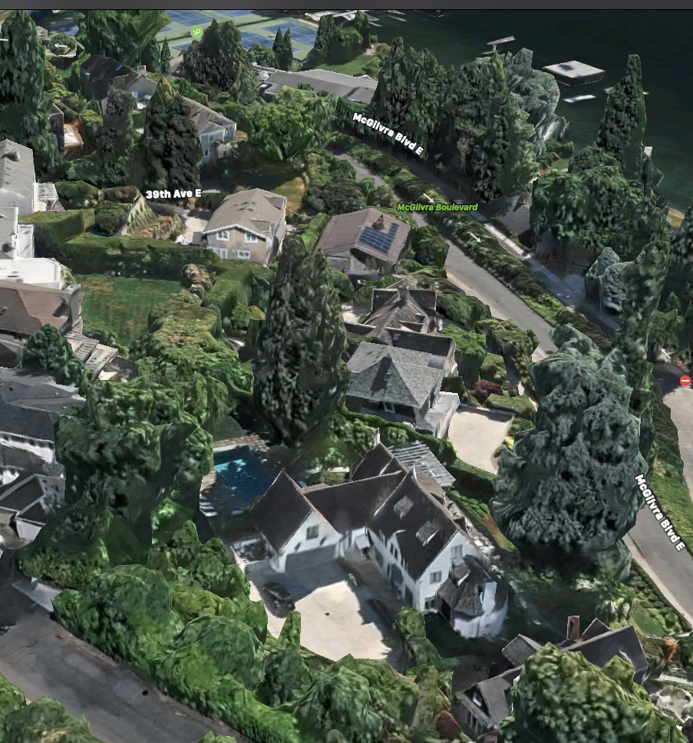
Recommondation 1
715 McGilvra Blvd E, Seattle, WA 98112, USA
House ID 18314
Built: 1926
Bathrooms: 4.75
Lot: 24085 sqft
Living: 4575 sqft
Grade: 10
Pool
0.2 miles to Tennis court
1 mile to Broadmoor Golf Club

Slide 10
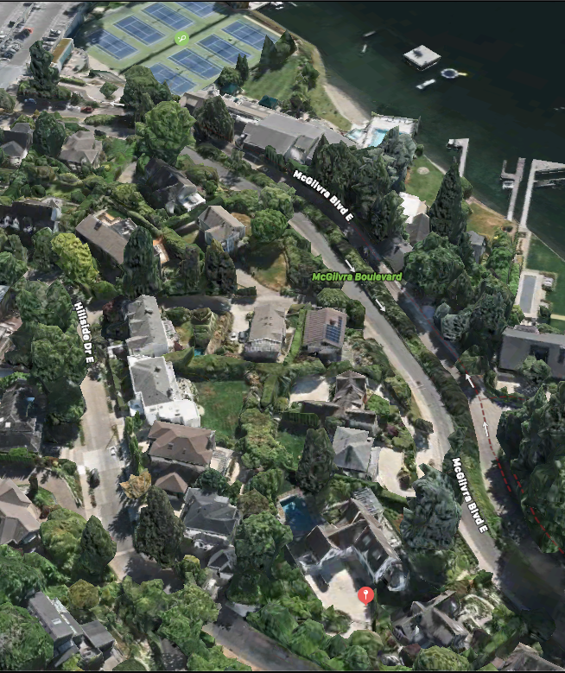
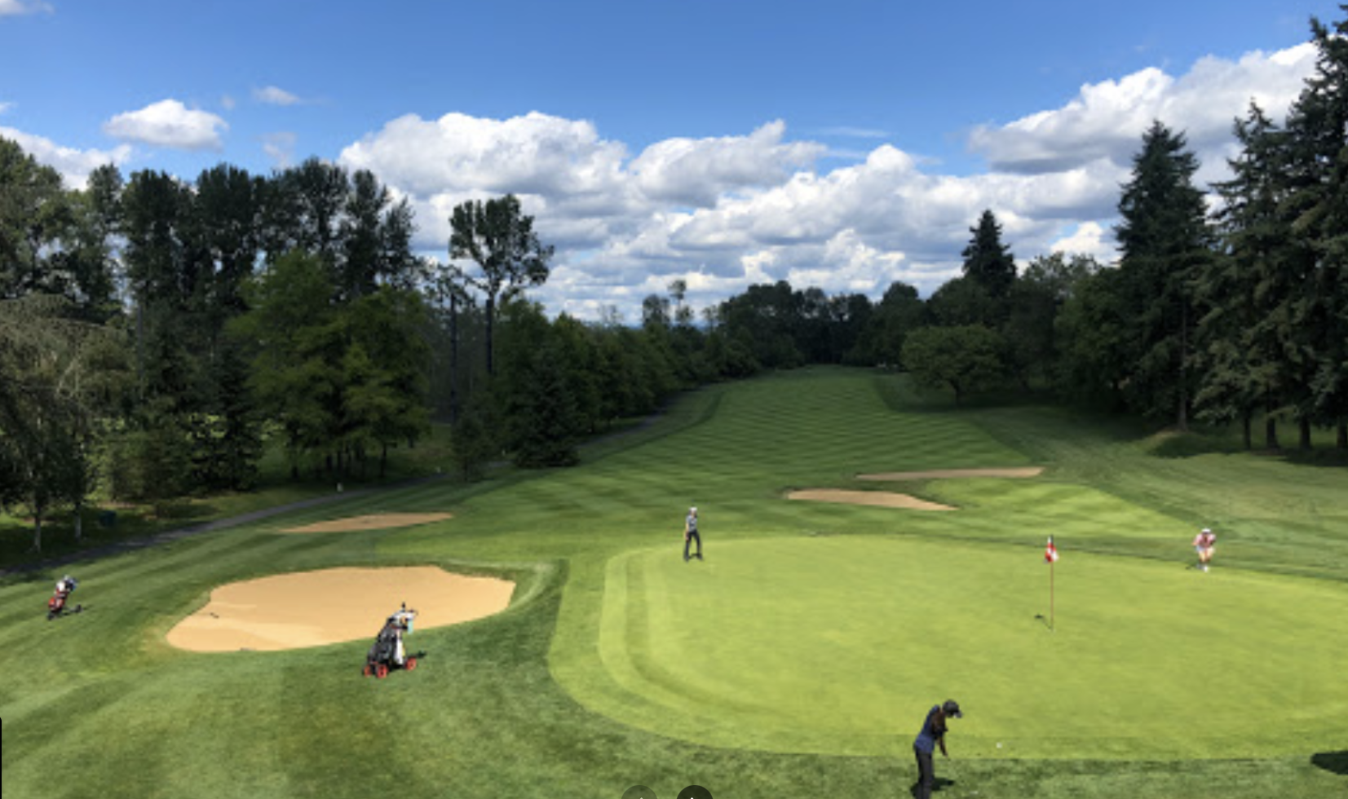
Recommondation 1
715 McGilvra Blvd E, Seattle, WA 98112, USA

Slide 11
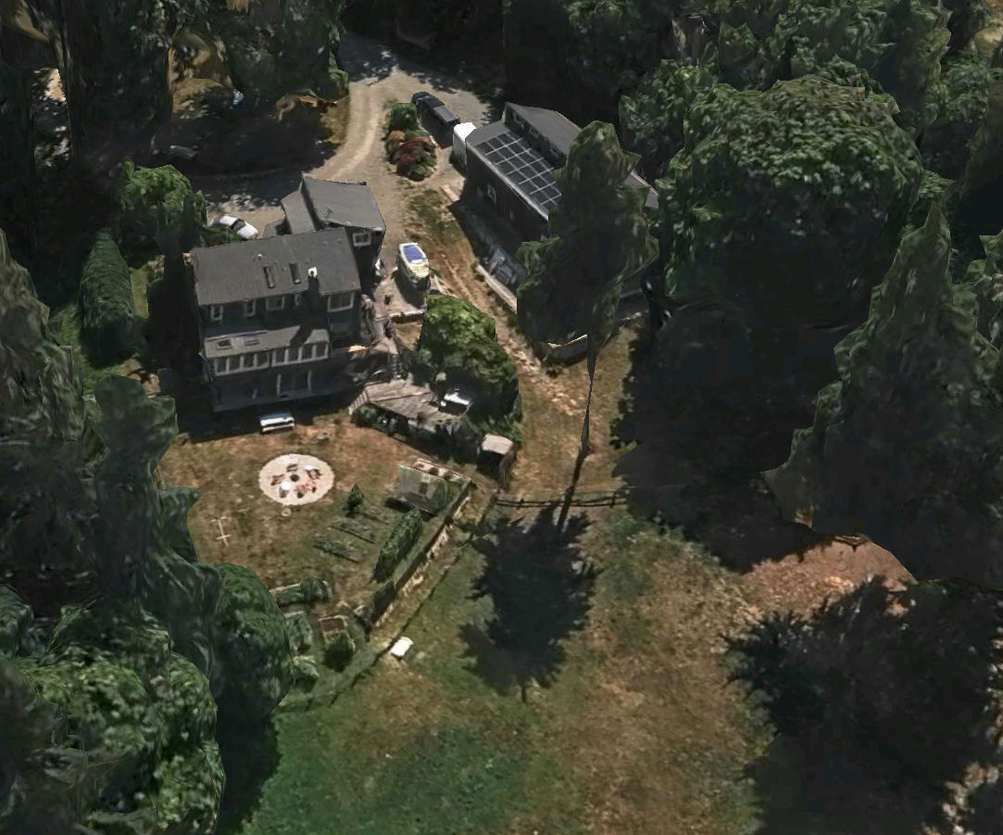
Recommondation 2
Maury Island, Vashon Island, Washington 98070, USA
House ID 10543
On Maury Island
Bathrooms: 4.25
Lot: 308.080 sqft, space for own Tennis court
Living: 3300 sqft
Grade: 9
Built: 1976
Boot, Private sea access
2 miles Vashon Island Golf

Slide 12
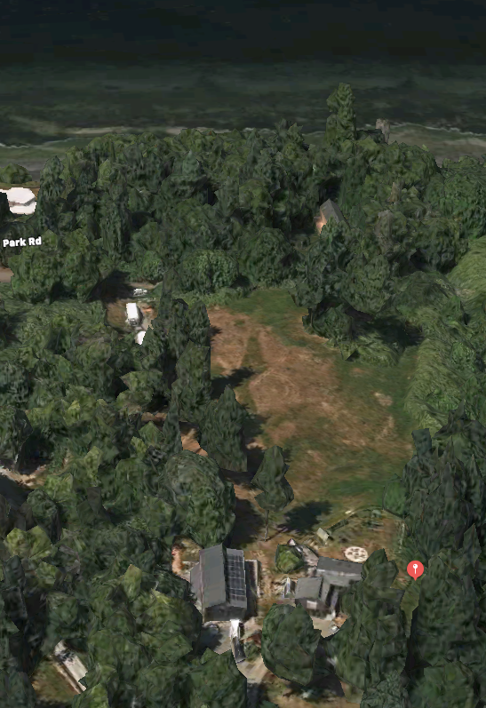
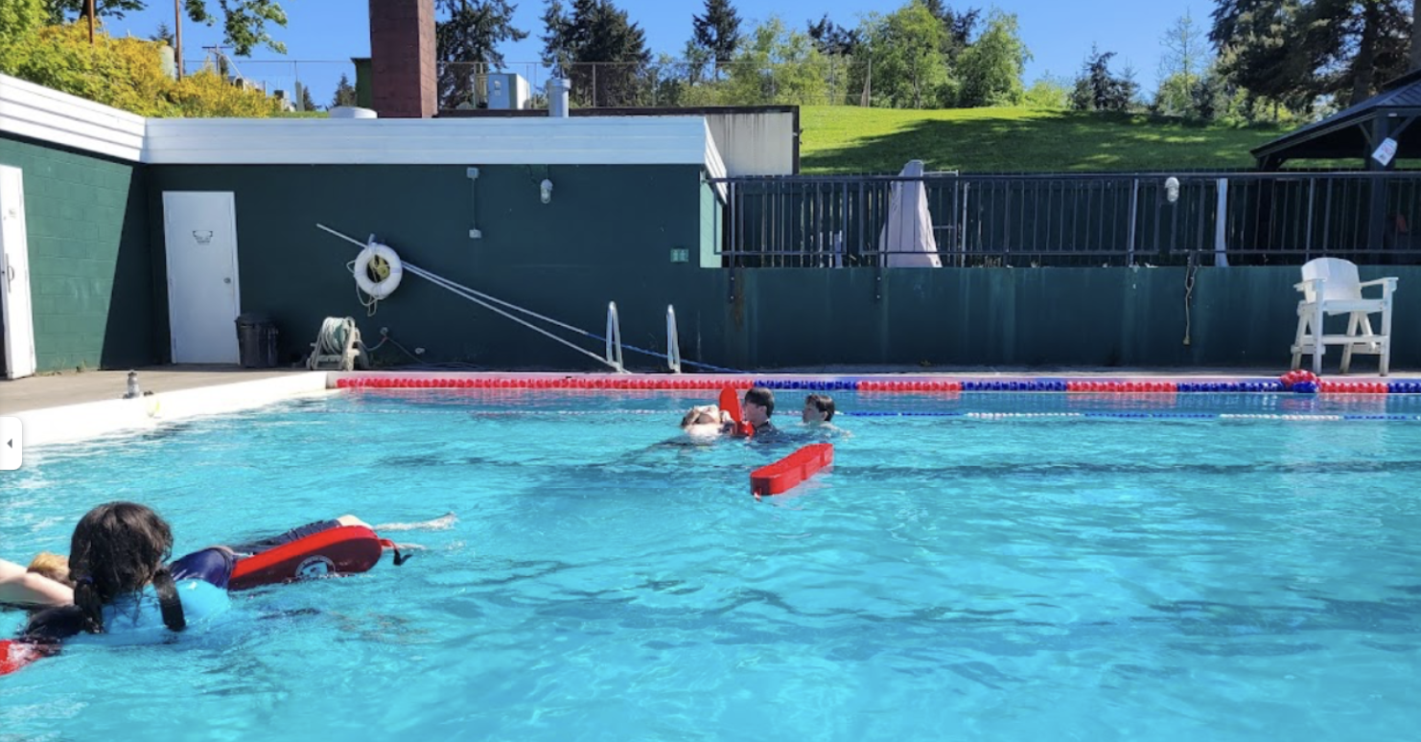
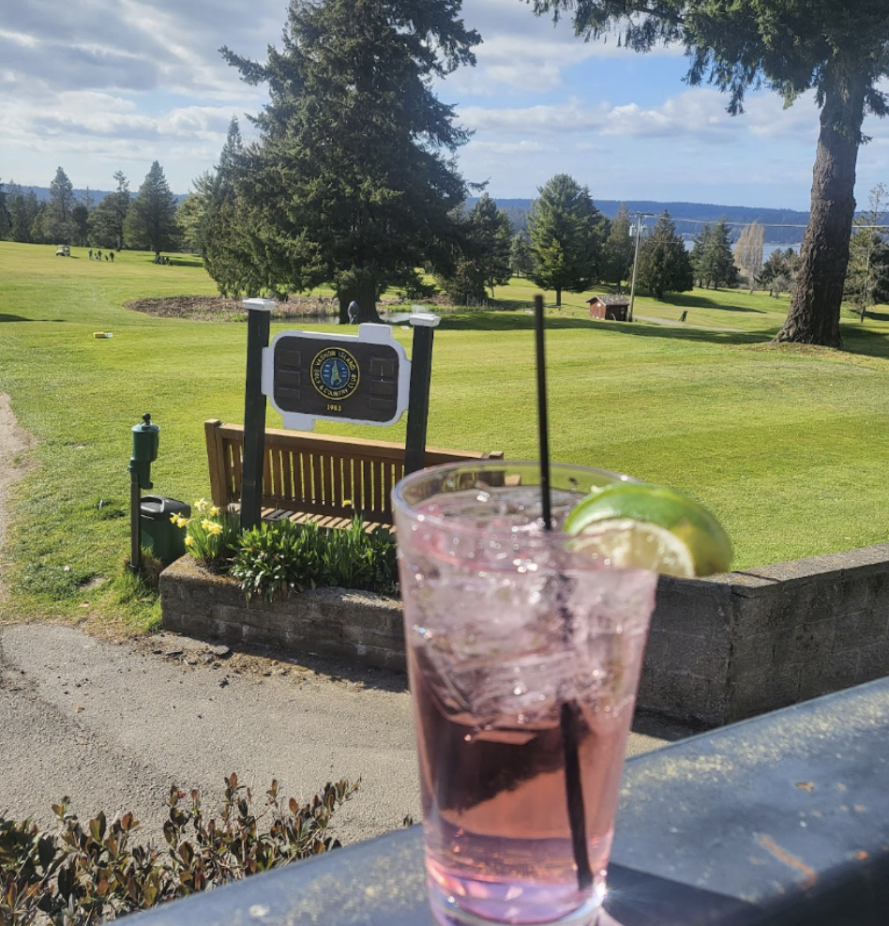
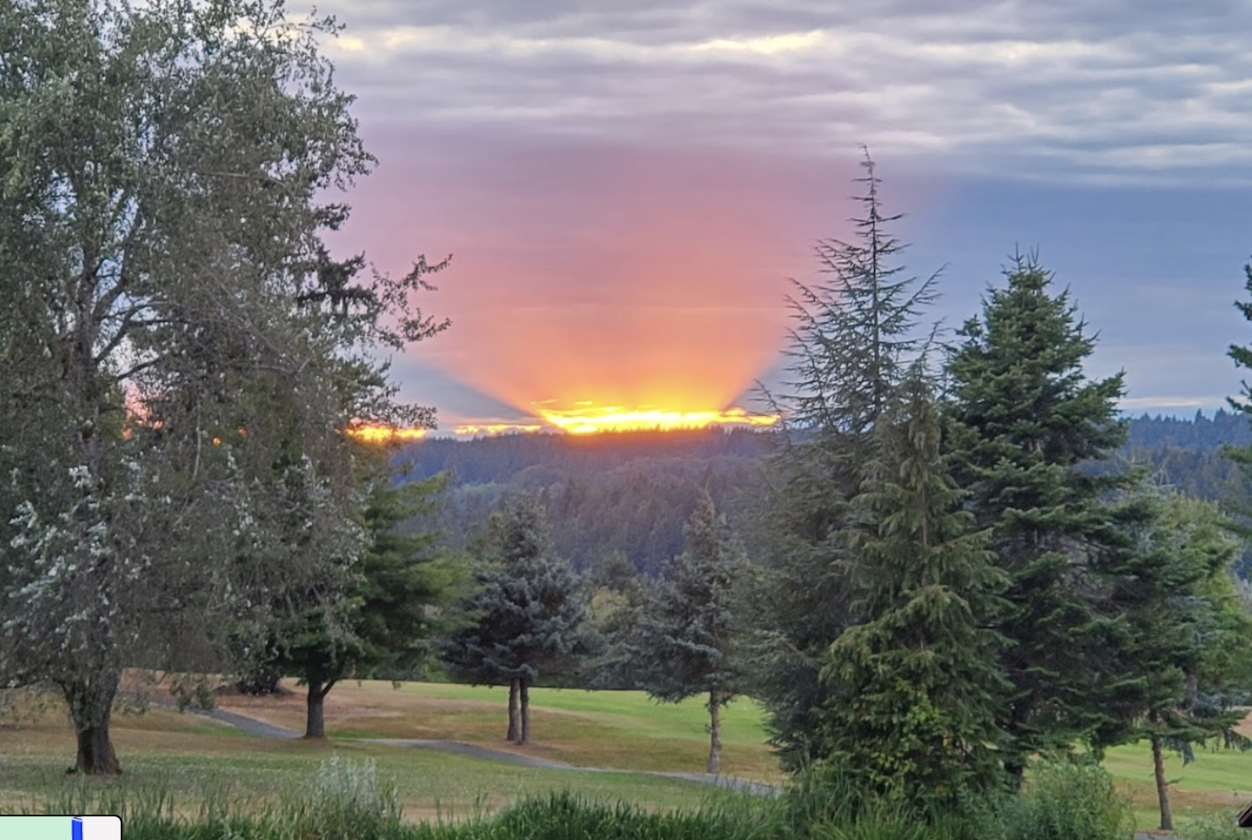
Recommondation 2
Maury Island, Vashon Island, Washington 98070, USA

Slide 13
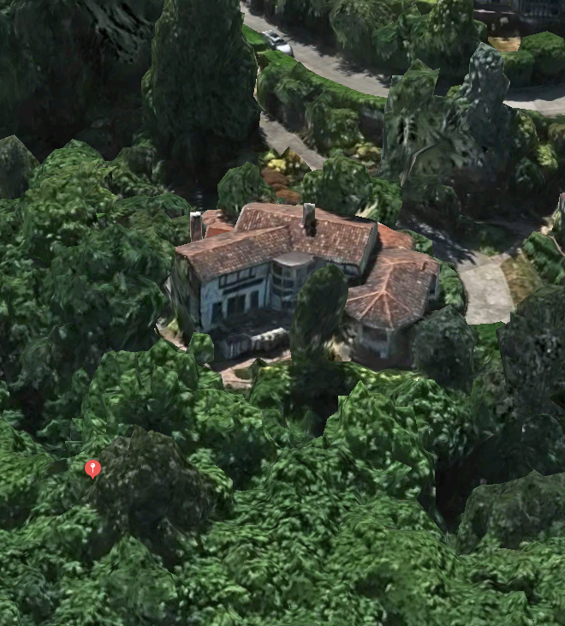
Recommondation 3
1509-1639 E Interlaken Blvd, Seattle, WA 98112, USA
House ID 14172
Bathrooms: 4.25
Lot: 30.120 sqft
Living: 4.200 sqft
Grade: 11
Built: 1933
Pool house
1,5 miles to Broadmoor Golf Club
1 mile to Montlake Playfield Tennis Court

Slide 14
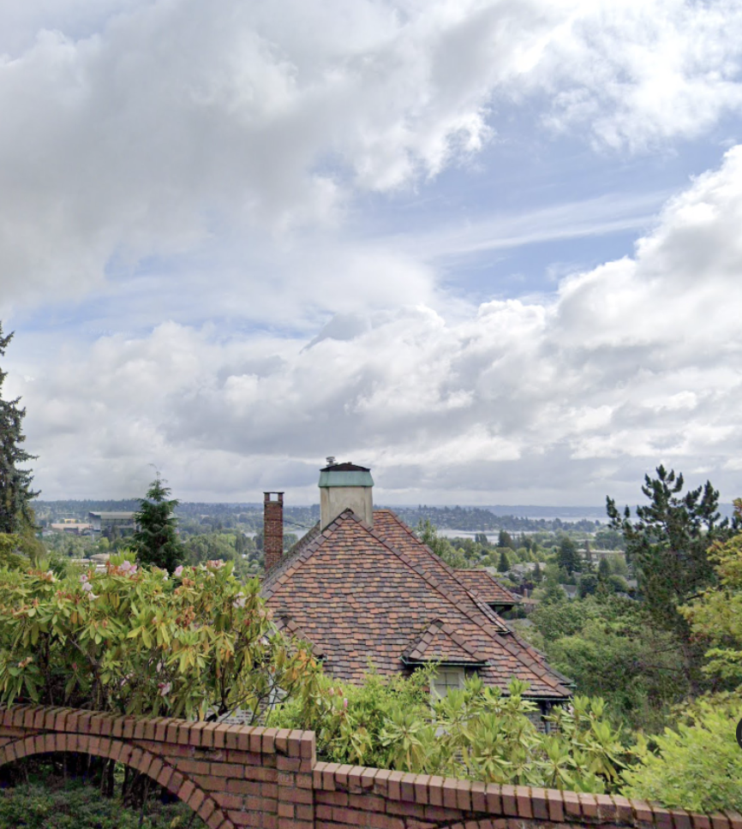
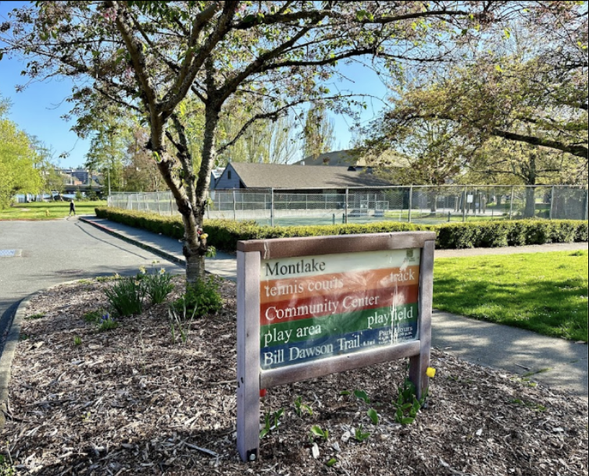
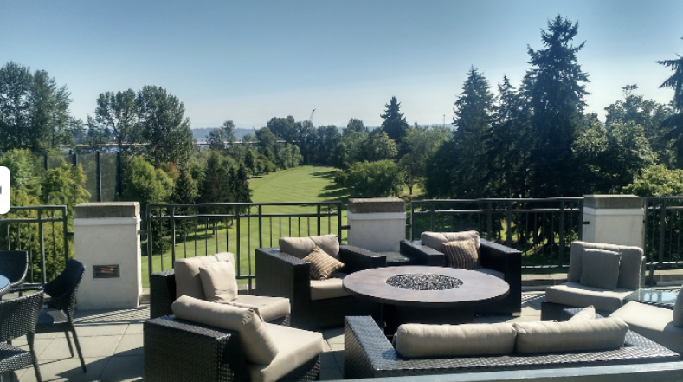
Recommondation 3
1509-1639 E Interlaken Blvd, Seattle, WA 98112, USA

Slide 15

Backhaus‘ Kings County Real Estates
Live Your Dreams

Slide 16
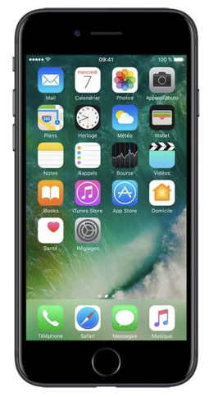
z
App Integration
Browse the list
Explore the neighborhoods

Slide 17
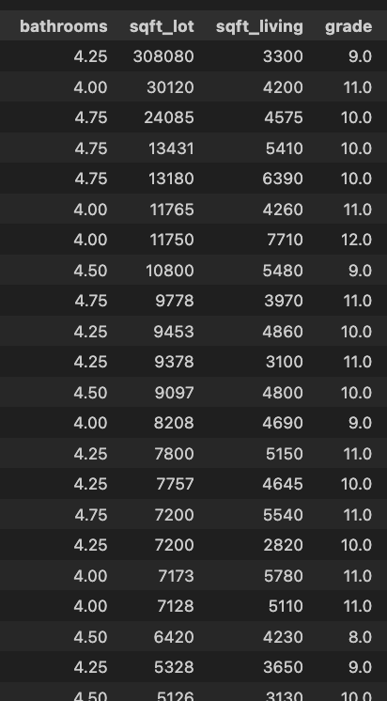
z
App Integration
Browse the list
Explore the neighborhoods

Slide 18
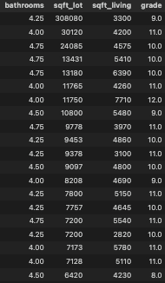
z
App Integration
Browse the list
Explore the neighborhoods

Slide 19
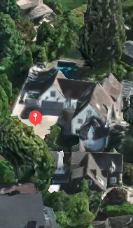
z
App Integration
Browse the list
Explore the neighborhoods

Slide 20

Your Real Estate
Live Your Dreams
Backhaus‘ Kings County Real Estates

Slide 21
Now your turn
Contact us:
Backhaus‘ King County Real Estates
1509-1639 E Interlaken Blvd, Seattle, WA 98112, USA

